Slide 1
Marketing Campaing analysis
06/04/2023

Slide 2
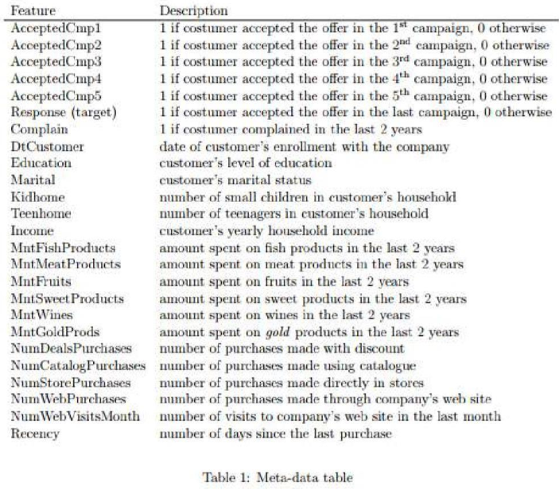
Dataset
Link of the dataset : https://www.kaggle.com/datasets/jackdaoud/marketing-data
This dataset has been provided by the company « ifood ».
It consists of 2240 rows. Each row represent a customer.

Slide 3
In this Project…
1. The aim of the project
2. Data Cleaning using power query
3. Insights
4. Dashboard

Slide 4
1. The aim of the project
In this project I would like to answer questions like :
Which marketing campaign is most successful?
Which products are performing best?
Which channels are underperforming?

Slide 5
2. Data cleaning using Power Query
Handle missing values
Data types
Drop the values that makes no sense
Drop duplicate rows

Slide 6
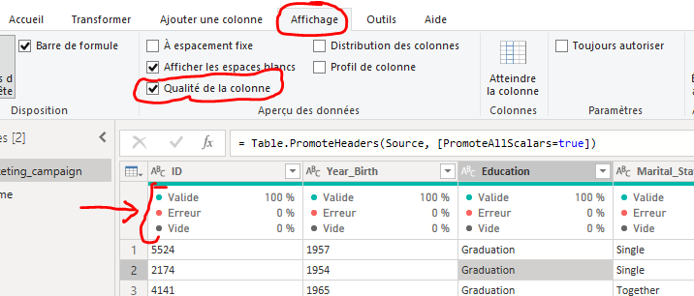
2. Data cleaning using Power Query
2.1 Handle missing value
This is a way to know if a column has missing values

Slide 7
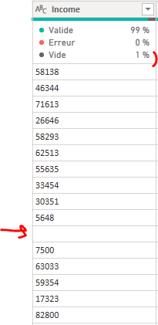
2. Data cleaning using Power Query
2.1 Handle missing value
The « Income » column has missing values
I replaced the missing value by the median :
  Select the income Column, right clic and then select « Ajouter en tant que nouvelle requête » (« Add as New Query »)
  Select « statistics » and then « Median »
  Select the « Income » column and then « remplacer les valeurs ».
  Replace 0 by the median
  Round the value

Slide 8
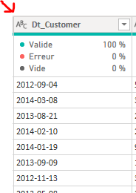
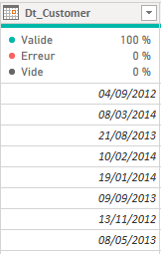
2. Data Cleaning using Power Query
2.2 Data type
DT_Customer column should be a date format and not an integer.

Slide 9
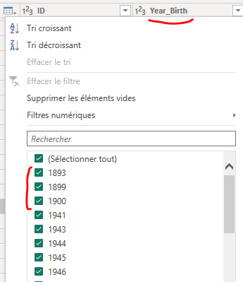
2. Data Cleaning using Power Query
2.3 Values that make no sense
Some values of the column « Year_Birth » are under 1900 so I removed these outliers.

Slide 10
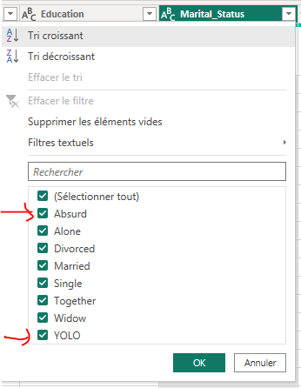
2. Data Cleaning using Power Query
2.3 Values that make no sense
I replaced these values by « alone » (I could have replaced them by « other »).

Slide 11
2. Data Cleaning using Power Query
2.4 Drop duplicate rows
I dropped the rows which have the same values.
  Some rows have exactly the same value in each column, but doesn’t have the same id (first column).
  It is very likely that some customers answered the survey twice.

Slide 12
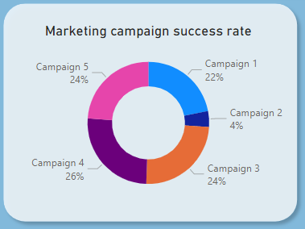
3. Insights
3.1 Which marketing campaign is most successful?
The fourth marketing campaign was the most successful.

Slide 13
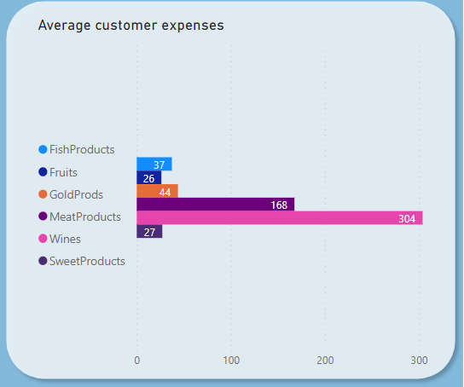
3. Insights
3.2 Which products are performing best?
On average, customers spend more money in wines.

Slide 14
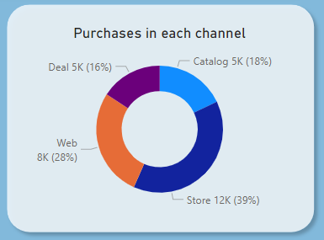
3. Insights
3.3 Which channels are underperforming?
It seems that the Catalog and Deal are not the channels customers use the most to buy products.

Slide 15
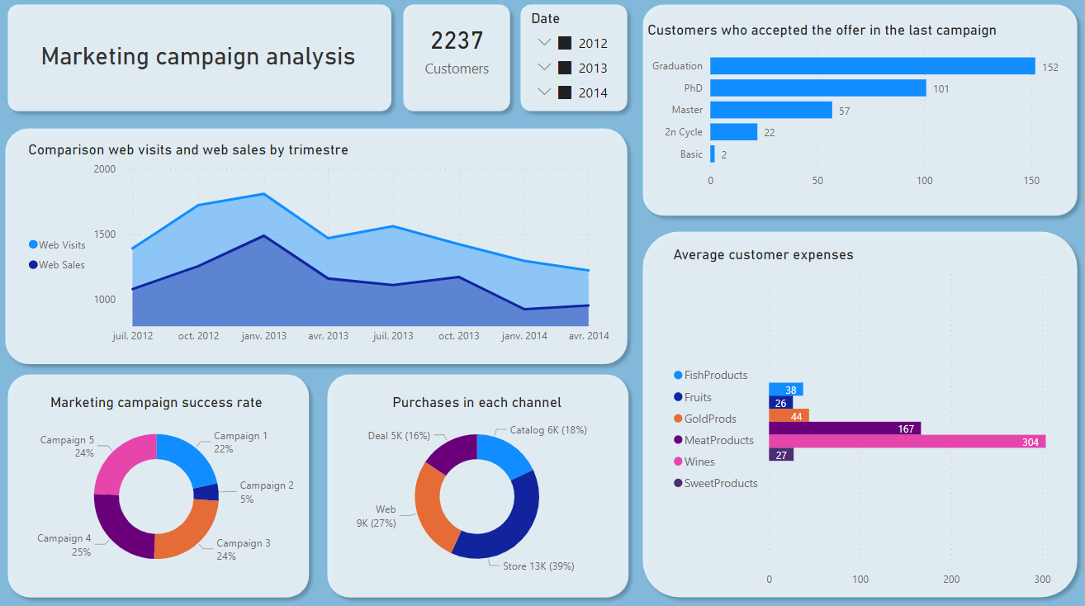
4. Dashboard
You can filter the data per year.
This is an example of what we can learn and visualize.
Further visualisations could be done depending on what the stakeholders want to know.

